Slide 1
Company Bankruptcy Prediction Classification presentation

Slide 2
Agenda
The goal of this machine learning project is to develop a predictive model that can assess the financial health of companies and predict the likelihood of bankruptcy based on various financial attributes.

Slide 3

Goal & Objectives You need to use machine learning algorithms and aim to analyse these financial attributes and build a predictive model that can classify companies as either financially healthy or at risk of bankruptcy. By leveraging historical financial data and company performance metrics, this model will help investors, financial analysts, and stakeholders identify early warning signs of financial distress and make informed decisions to mitigate risks.

Slide 4

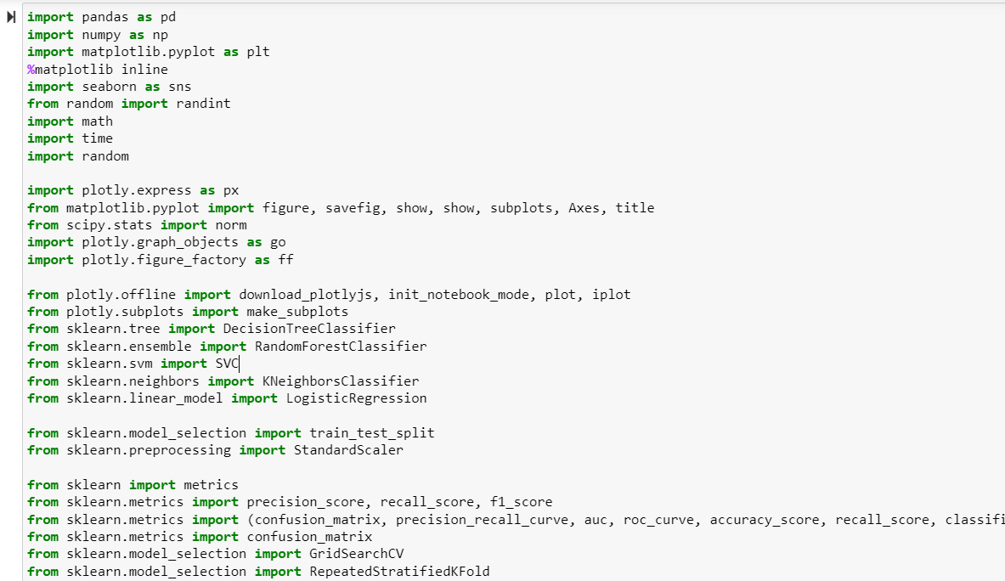
Import the require libraries

Slide 5
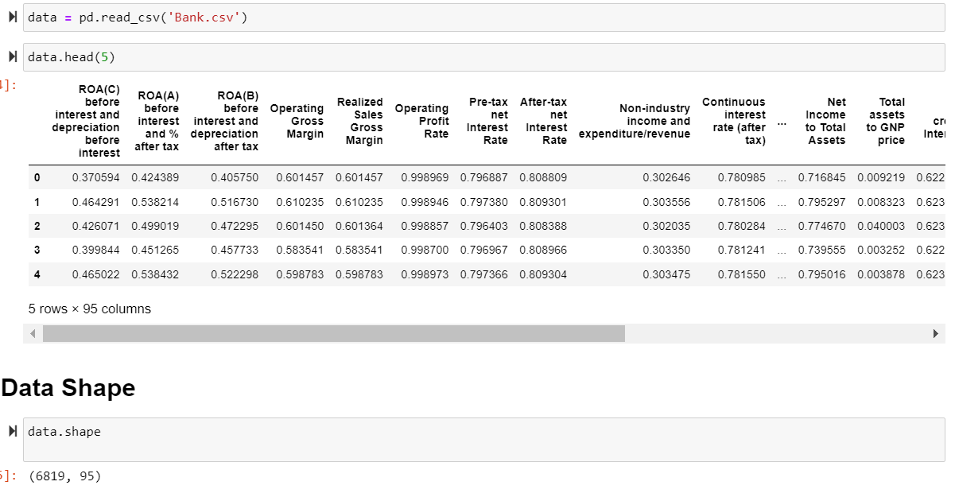
Import the data given and checking the shape and first 5 columns

Slide 6
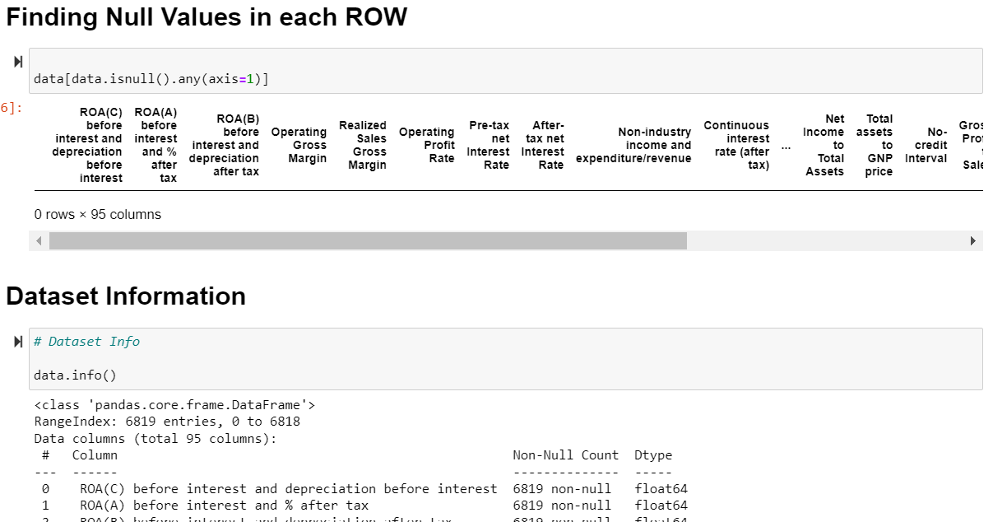
checking the null values and data type info
Seems that there is no null values, and all the columns are float and int data type

Slide 7
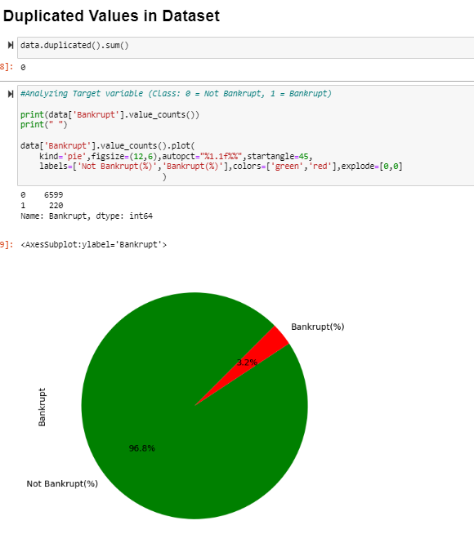
Duplicate vales and Graph on Target variable​
1. No Duplicate values in dataset
2. Pie graph shows the target contains 96.8% of Not Bankrupt data and only 3.2% of Bankrupt data.

Slide 8
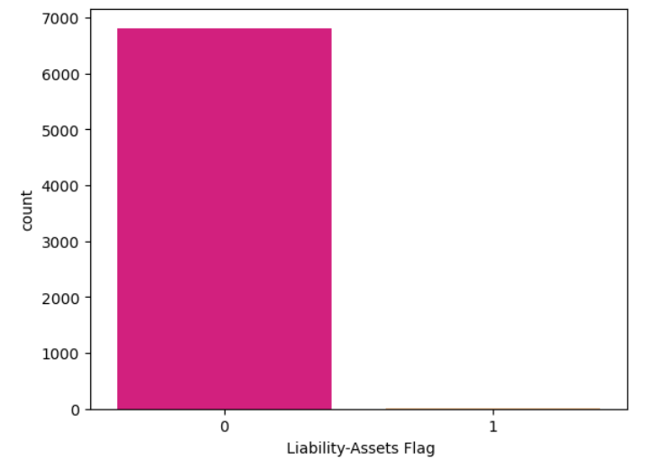
Analysis of Liability Assets of a company
The "Liability-Assets" flag denotes the status of an organization, where if the total liability is more that total assets, the flagged value will be 1, else the value is 0. A majority number of times, organizations/company's assets are more than their liabilities.
Assets are the items your company owns that can provide future economic benefit. Liabilities are what you owe other parties. In short, assets put money in your pocket, and liabilities take money out!

Slide 9
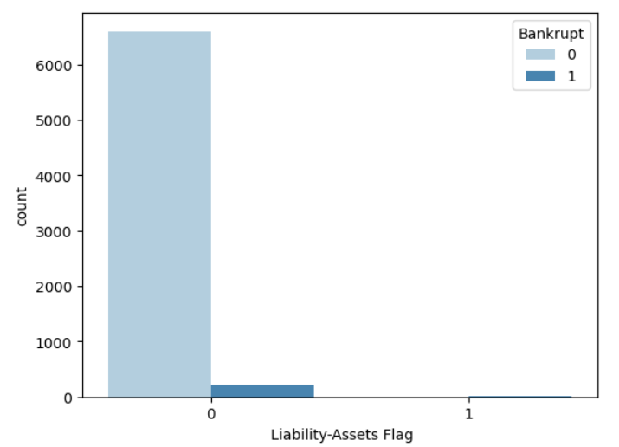
Analysis of Liability - Assets with Bankrupt.
On the above graph we can observe:
A small portion of organizations suffers bankruptcy, although more assets than their liabilities.

Slide 10
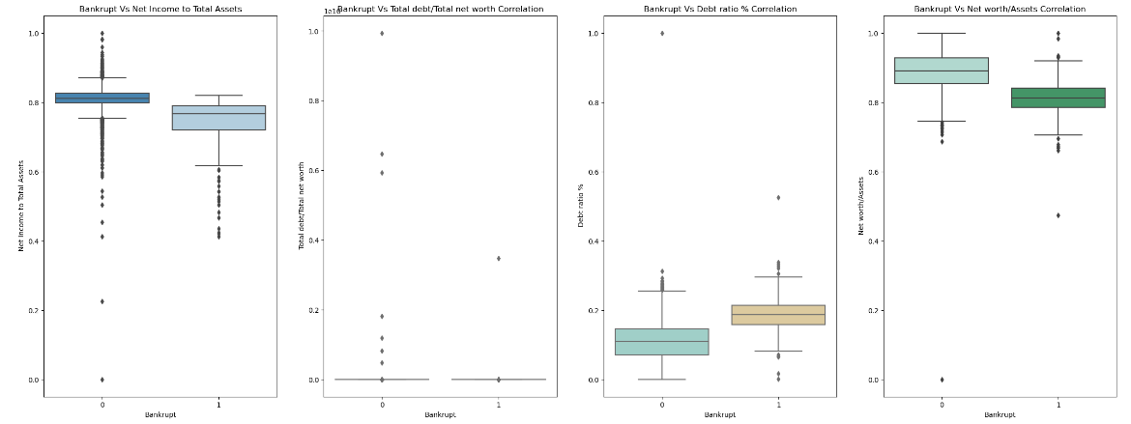
Data is symmetric or not symmetric
Data is not symmetric and is skewed and it can be seen that there are a lot multicollinearity issues, skewed features, and the data is imbalanced. With all that in mind for this model it is better not to use regression (logistic regression), it is better to use decision tree model.

Slide 11
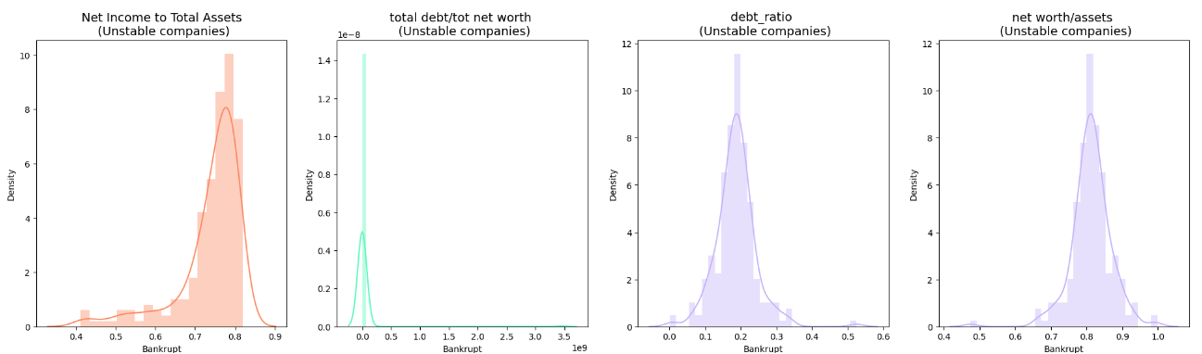
variation in the data distribution
The above graph shows for continuous data variables VS Bankrupt. I used this distribution to find the matching possible distribution.
Distribution of features for companies that are close to bankruptcy

Slide 12
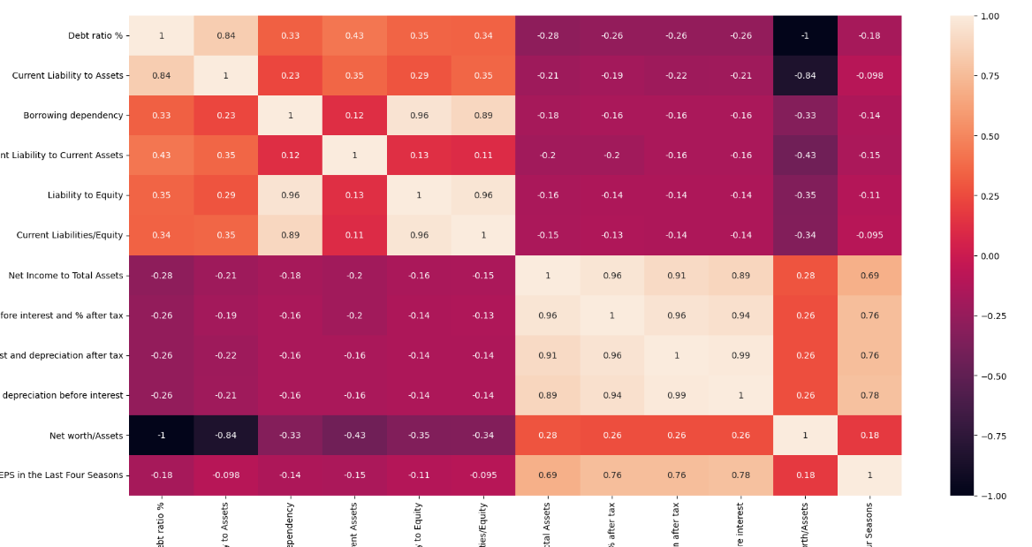
correlated attributes Categorical - Numerical variables
From the above we observed several correlations among the top 12 attributes, one of which being “Net Worth/Assets and Debt Ratio %” that is negatively correlated with one another.
Rest all correlation can be depicted from the above chart.

Slide 13

Feature engineering
Missing values detection
Columns Manipulation
Outliers' detection and removing

Slide 14
- From the above data check we found that there is not null values in data.
- From the above graphs we found that all the data is required for the prediction no need to remove outliers.

Slide 15
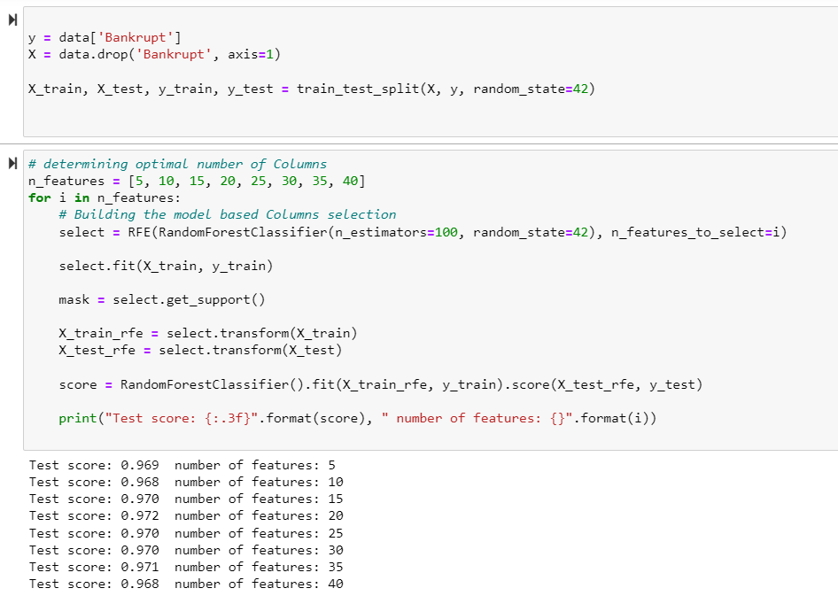
Columns Manipulation
To find out the best columns for model Random forest classifier is best to found
Oat first I have split the data and created a gird search technic to found the best number of columns required.
On the model we found that 15 columns gives the best prediction.

Slide 16
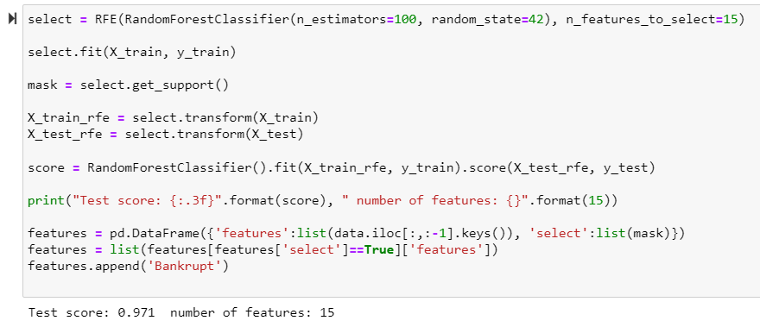
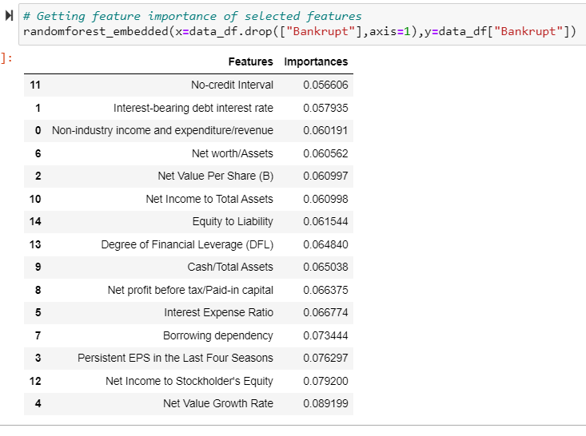
Getting Column's importance
By using Random forest, we have found the 15 best columns for prediction and their importance.

Slide 17
ML Model Implementation
Data Splitting
Data Scaling
Model Implementation
Finding Accuracy
Plot the confusion matrix

Slide 18
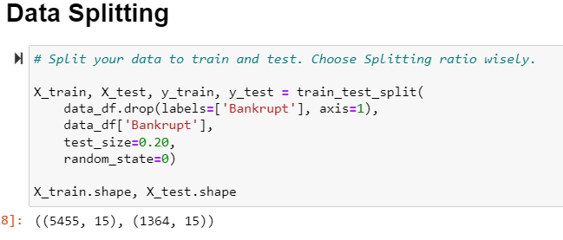
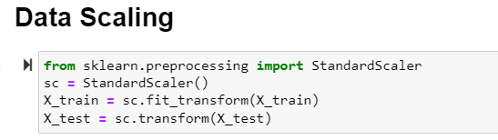
Data splitting and scaling

Slide 19
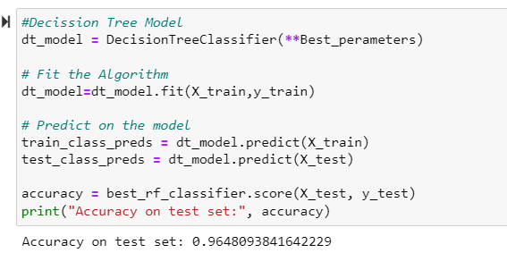
Decision Tree Classifier
By using Decision tree Classifier, we found that Accuracy is 0.964

Slide 20
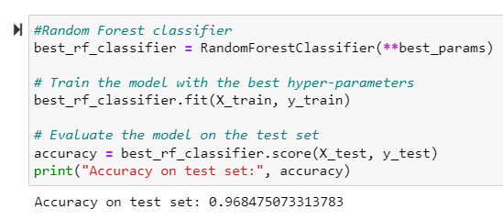
Random Forest Classifier
By using Random Forest Classifier, we found that Accuracy is 0.968

Slide 21
Conclusion
In this project, we developed and evaluated two machine learning models, namely Decision Tree and Random Forest, for predicting bankruptcy. The objective of the project was to build robust models that could effectively classify companies as bankrupt or non-bankrupt based on various financial features.
Both the Decision Tree and Random Forest models showed promising results in terms of predictive performance. However, after thorough evaluation, we found that the Random Forest model outperformed the Decision Tree model in terms of accuracy and generalization to unseen data.
The Random Forest model achieved an accuracy of 0.968 on the test dataset, while the Decision Tree model achieved an accuracy of 0.964. This indicates that the Random Forest model was better able to capture the complex relationships between the input features and the target variable.

Slide 22
Furthermore, we conducted feature importance analysis to identify the most influential features in predicting bankruptcy. The analysis revealed were the most important features which are given below in both models, highlighting their significance in determining the financial health of companies.
‘ Non-industry income and expenditure/revenue’,
' Interest-bearing debt interest rate’,
' Net Value Per Share (B)’,
' Persistent EPS in the Last Four Seasons’,
' Net Value Growth Rate’,
' Interest Expense Ratio’,
' Net worth/Assets', ' Borrowing dependency’,
' Net profit before tax/Paid-in capital’,
' Cash/Total Assets’,
' Net Income to Total Assets’,
' No-credit Interval’,
' Net Income to Stockholder's Equity’,
' Degree of Financial Leverage (DFL)’,
' Equity to Liability’
Overall, the results of this project demonstrate the effectiveness of machine learning techniques in predicting bankruptcy and provide valuable insights for stakeholders, such as investors and financial institutions, in assessing the risk associated with potential investments.

Slide 23
THANK YOU
In future work, we could explore additional feature engineering techniques, fine-tuning of hyperparameters, and alternative algorithms to further improve the predictive performance of the models.
Feel free to customize this conclusion based on your specific results and findings from your project.
Sai Chaitanya Kumar
8463925133
saichaitanyakumar2012@gmail.com​

